Slide 1
Randomized incremental Algorithm-Implementation in Python Team 4

Slide 2
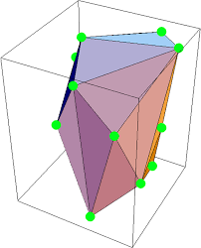
What is Randomized incremental Algorithm?
A randomized incremental algorithm is an incremental algorithm in which the elements are added in a uniformly random order.

Slide 3
In computational geometry, a standard technique to build a structure like a convex hull or Delaunay triangulation is to randomly permute the input points and then insert them one by one into the existing structure. The randomization ensures that the expected number of changes to the structure caused by an insertion is small, and so the expected running time of the algorithm can be bounded from above. This technique is known as randomized incremental construction.

Slide 4
Advantages of Randomized Algorithms
Randomized algorithms are often faster either from the worst-case asymptotic point of view or/and from the numerical implementations point of view
Randomized algorithms are often (much) simpler than deterministic ones for the same problem.
Randomized algorithms are often easier to analyse and/or reason about especially when applied in counter-intuitive settings.

Slide 5
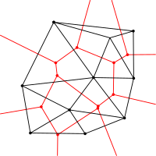
Randomized Construction One popular and efficient method, applied to the Delaunay triangulation at the end of the 1980s, is Randomized Incremental Construction (RIC). The idea is to exploit the simplicity of an incremental algorithm whilst avoiding its worst case behavior by simply adjusting the order of insertion of the points. n. All these algorithms are incremental and their complexity is randomized, they use some location structure to find where the new point is inserted, and then update the triangulation.

Slide 6
What is Delaunay Triangulation ?
Given a set of points in a plane, a triangulation refers to the subdivision of the plane into triangles, with the points as vertices. In Figure, we see a set of landmarks on the left image, and the triangulation in the middle image. A set of points can have many possible triangulations, but Delaunay triangulation stands out because it has some nice properties. In a Delaunay triangulation, triangles are chosen such that no point is inside the circumcircle of any triangle.

Slide 7
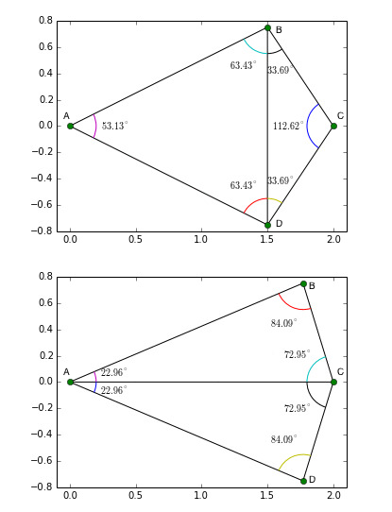
Figure shows Delaunay triangulation of 4 points A, B, C and D. In the top image, for the triangulation to be a valid Delaunay triangulation, point C should be outside the circumcircle of triangle ABD, and point A should be outside the circumcircle of triangle BCD.
An interesting property of Delaunay triangulation is that it does not favor “skinny” triangles ( i.e. triangles with one large angle ).
Figure shows how the triangulation changes to pick “fat” triangles when the points are moved. In the top image, the points B and D have their x-coordinates at x = 1.5, and in the bottom image they are moved to the right to x = 1.75. In the top image angles ABC and ABD are large, and Delaunay triangulation creates an edge between B and D splitting the two large angles into smaller angles ABD, ADB, CDB, and CBD. On the other hand in the bottom image, the angle BCD is too large, and Delaunay triangulation creates an edge AC to divide the large angle.

Slide 8
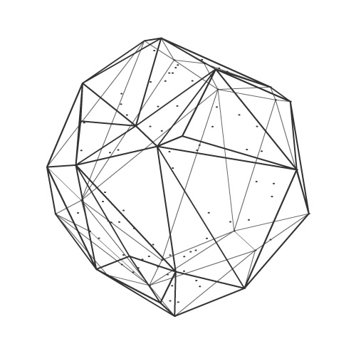
Randomized Incremental Convex Hull
The randomized incremental convex hull algorithm is one of the most practical and important geometric algorithms in the literature. Due to its simplicity, and the fact that many points or facets can be added independently, it is also widely used in parallel convex hull implementations.

Slide 9
Implementation of Delaunay Triangulation based on Randomized Incremental Algorithm

Slide 10
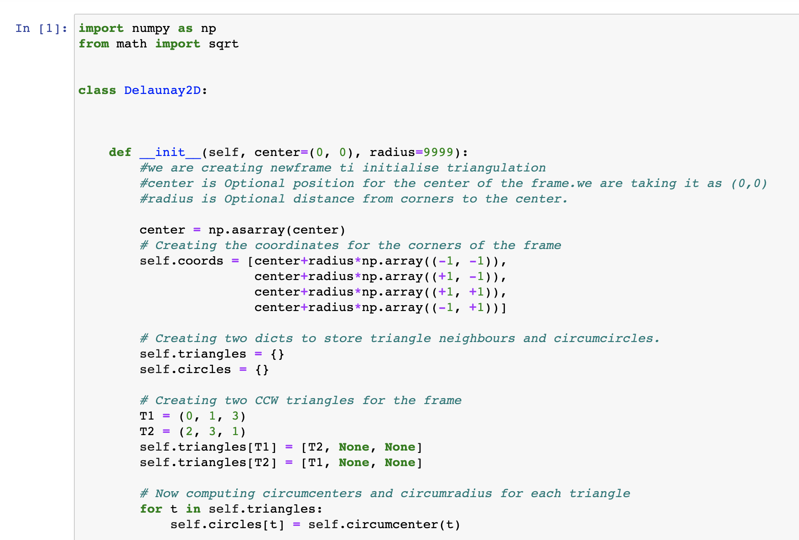

Slide 11
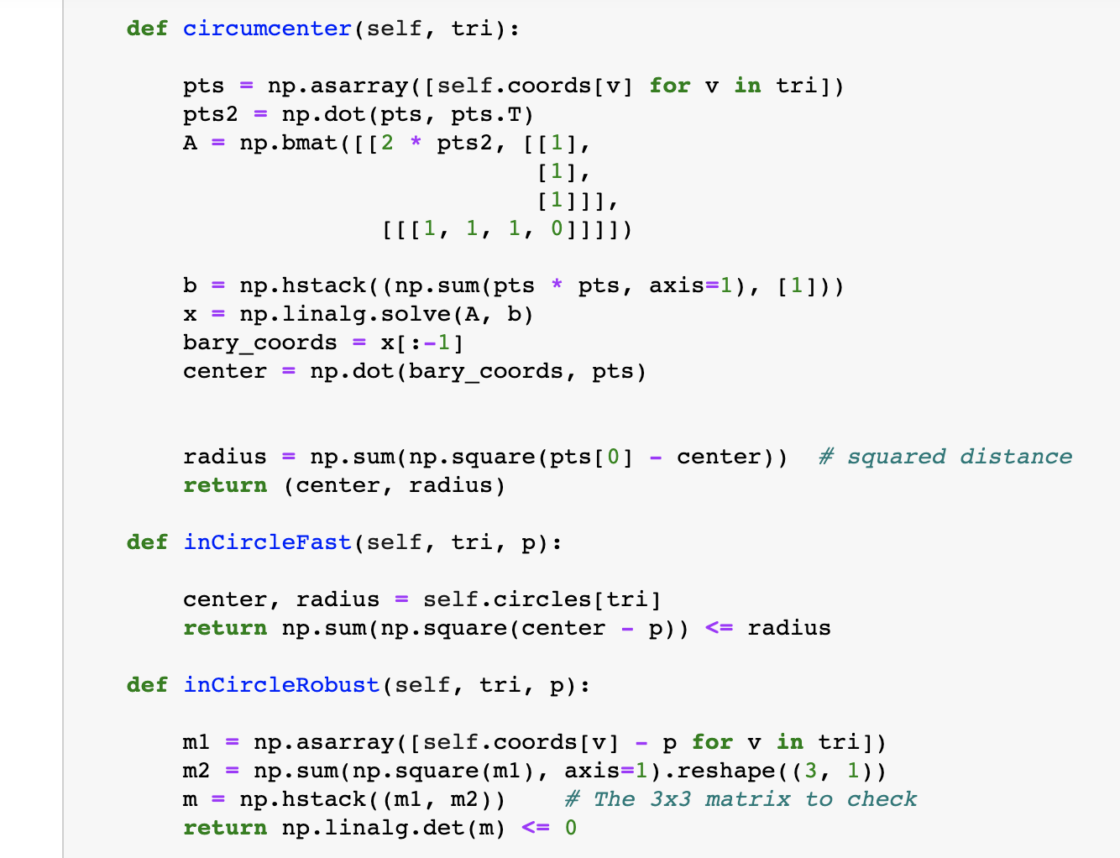

Slide 12
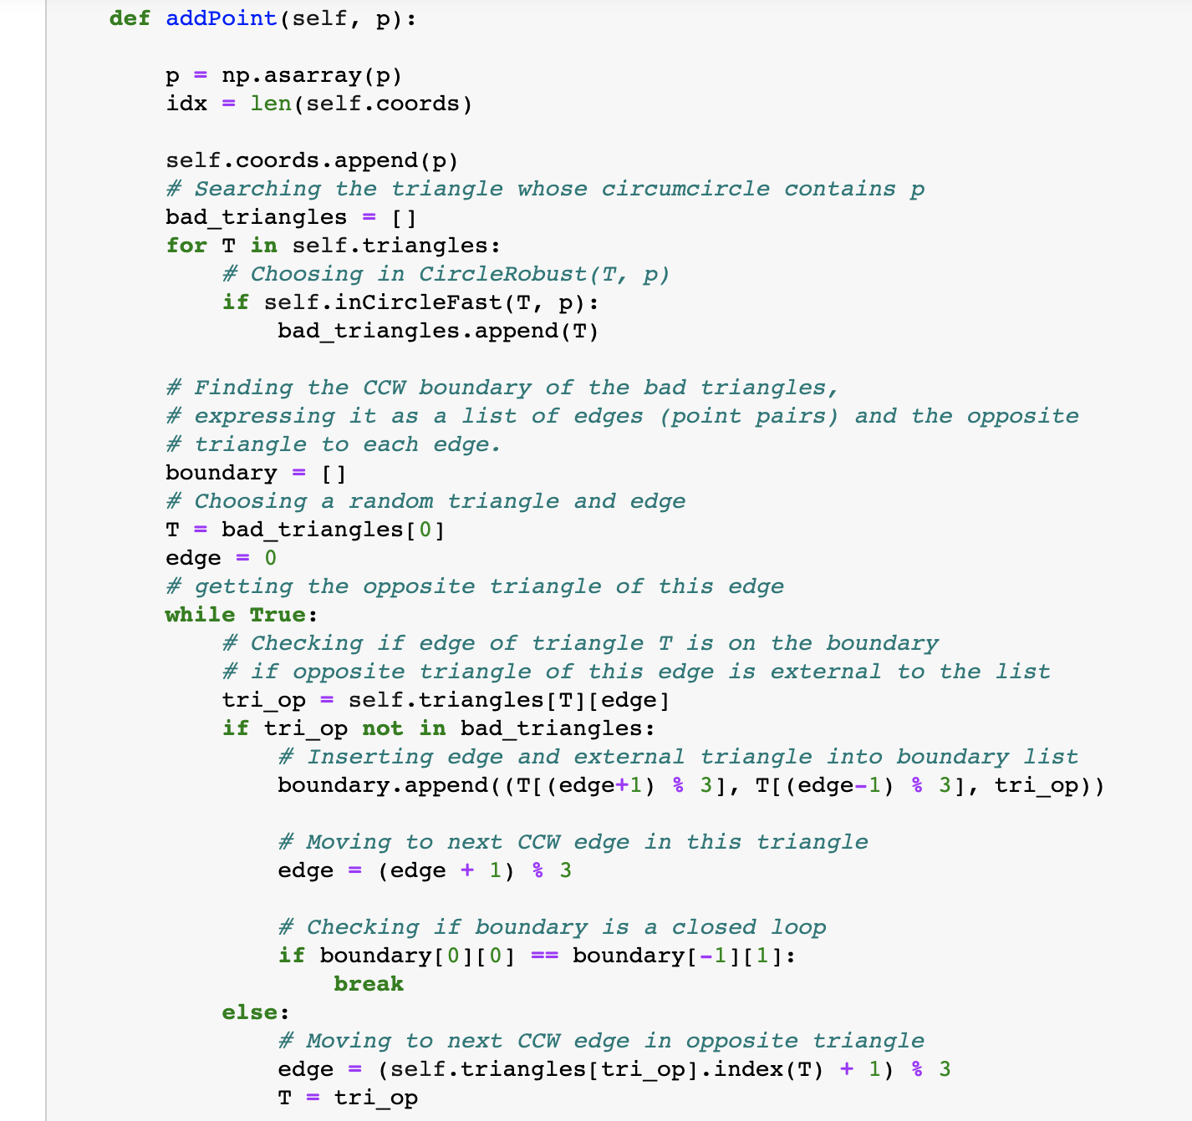

Slide 13
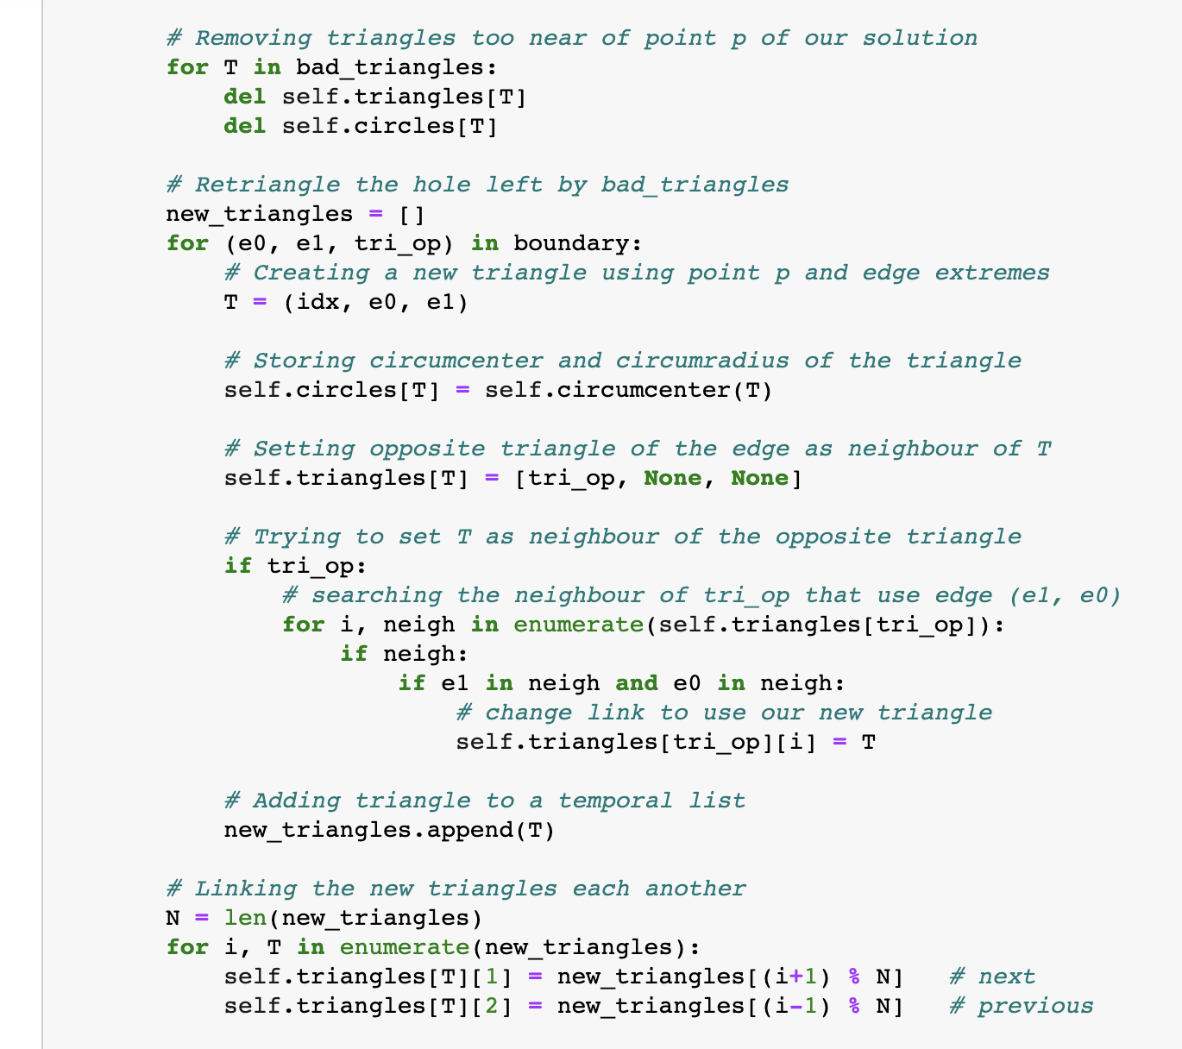

Slide 14
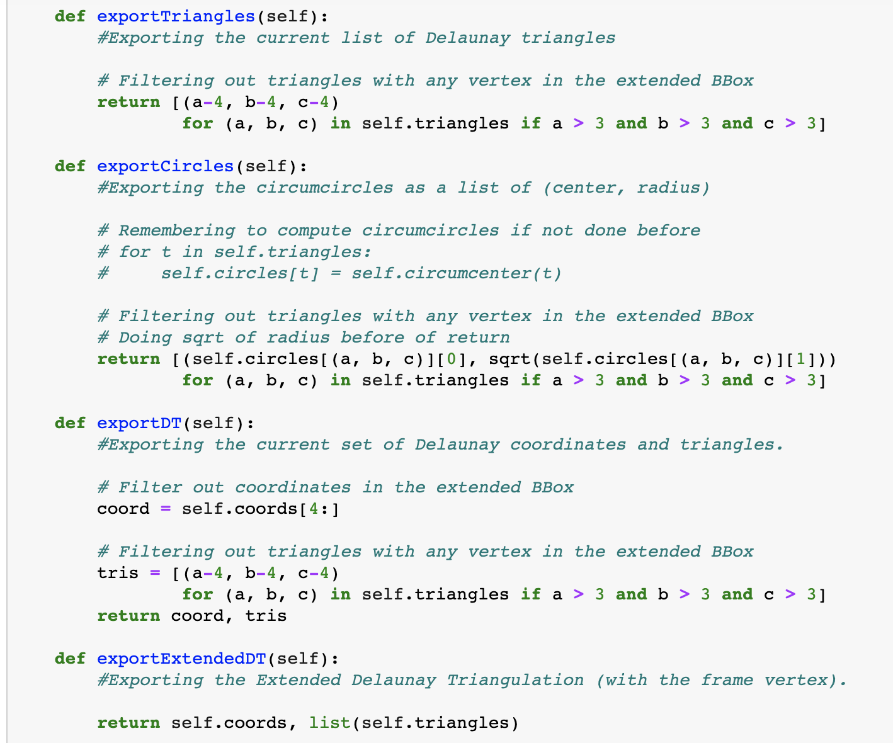

Slide 15
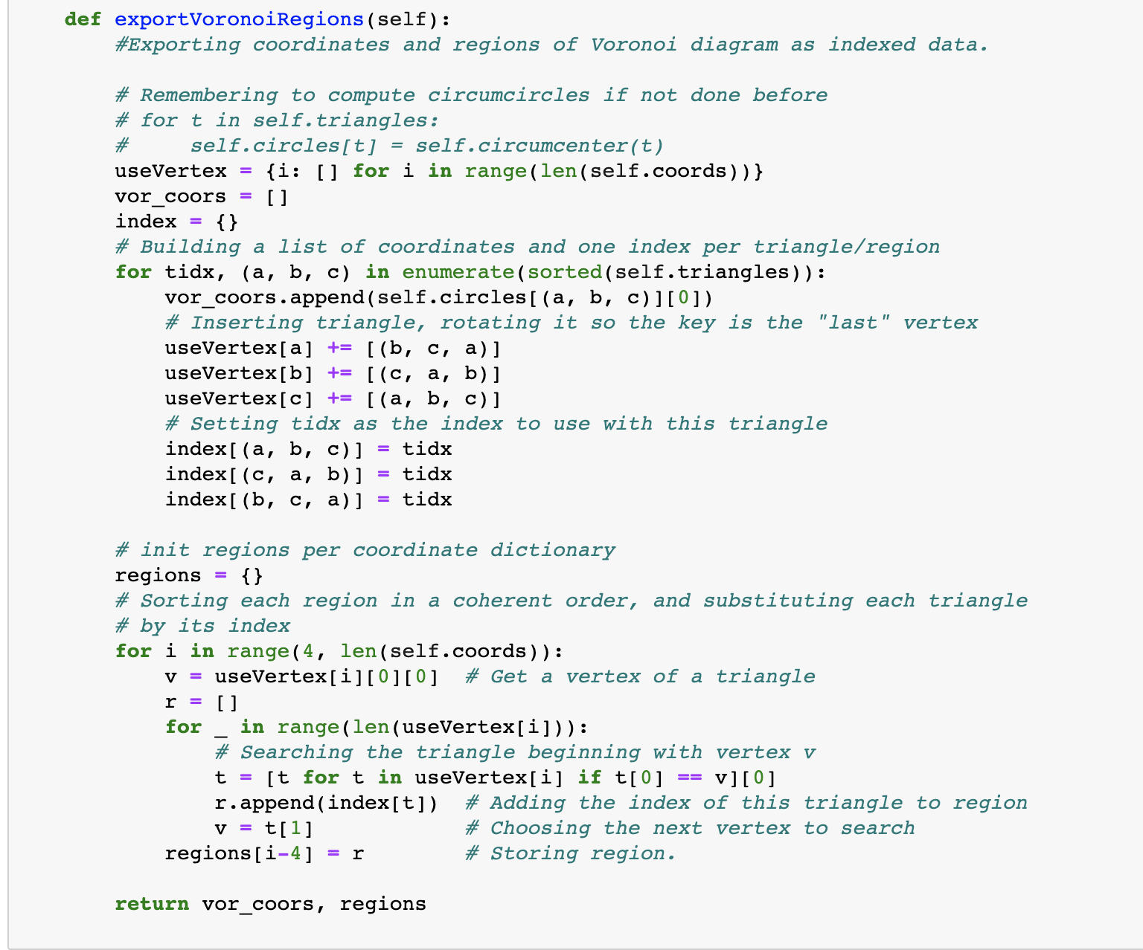

Slide 16
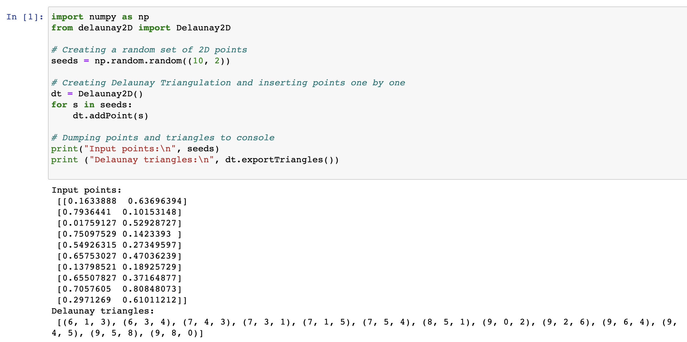

Slide 17
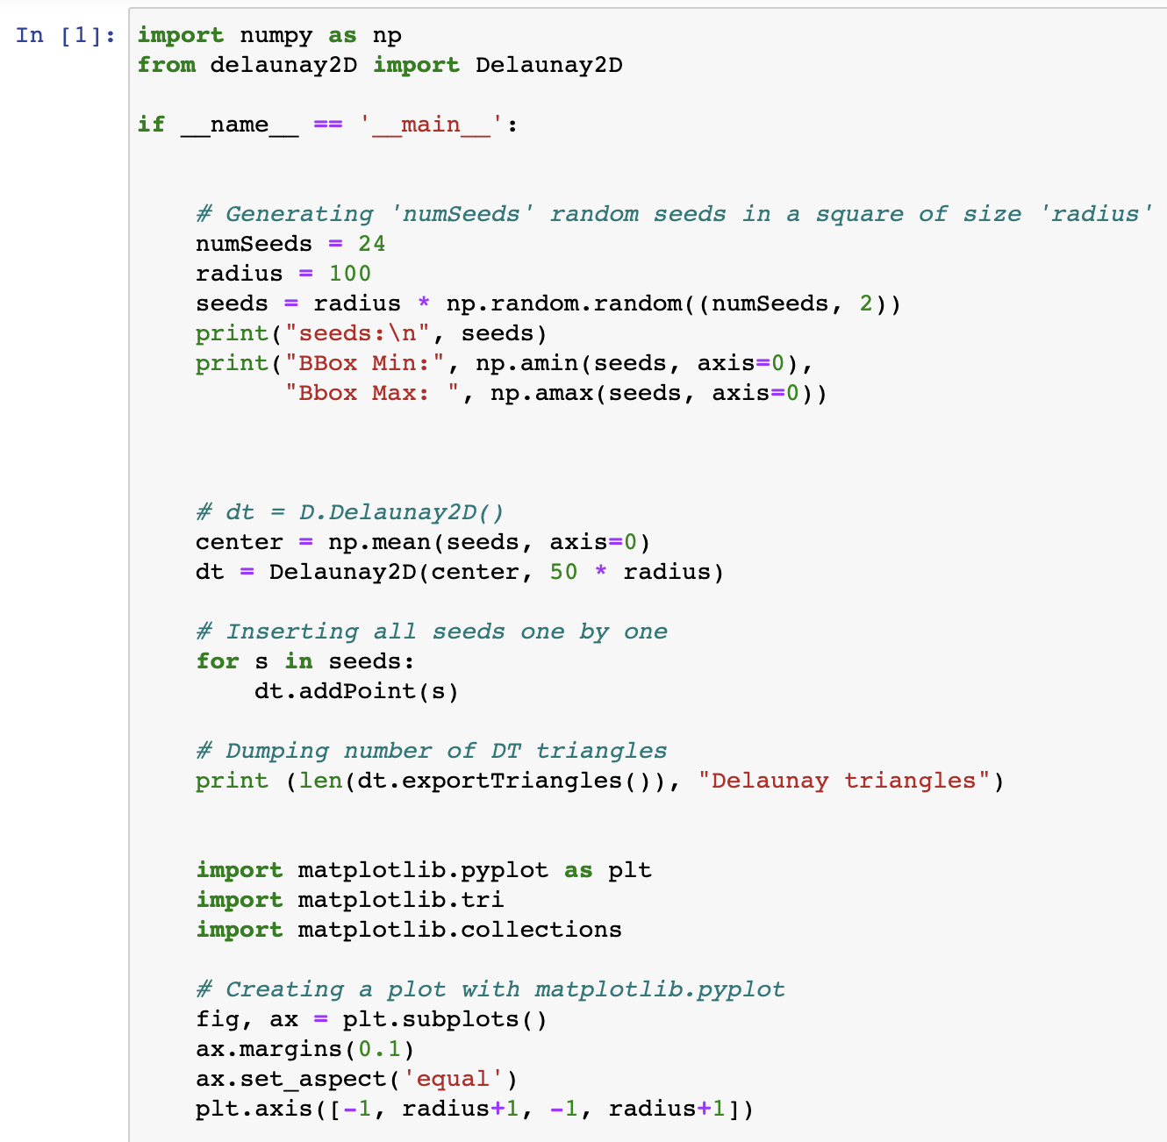

Slide 18
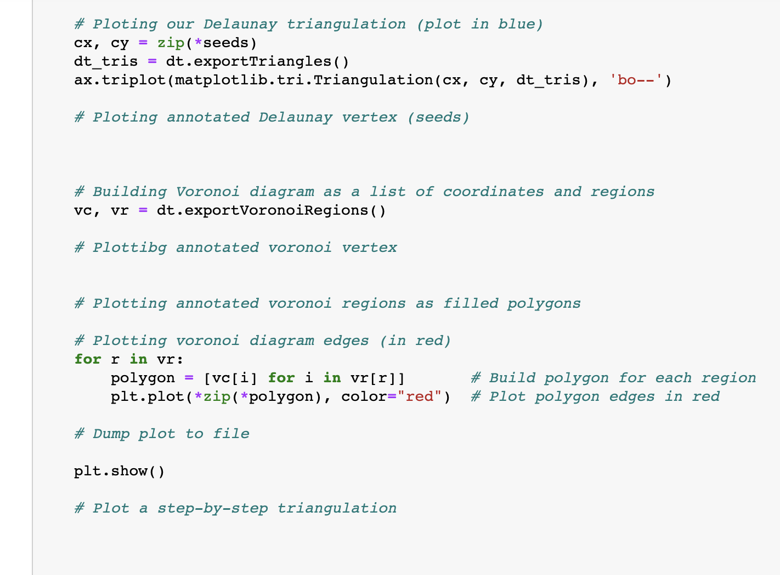

Slide 19
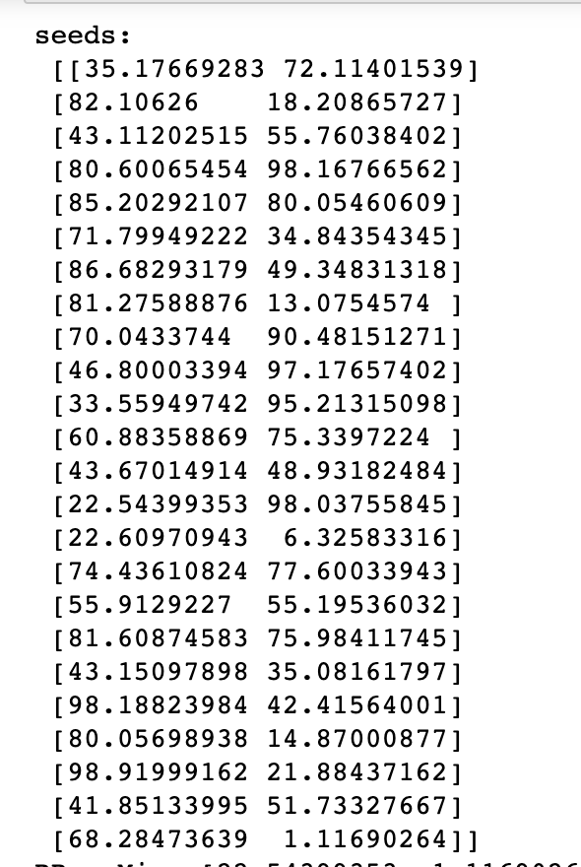
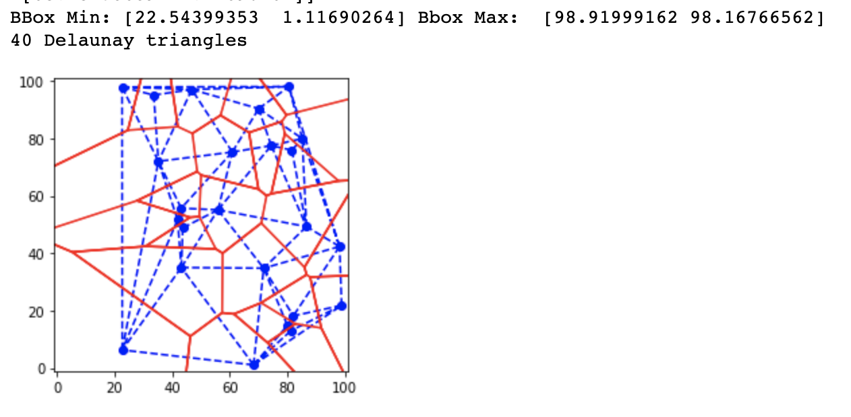
OUTPUT

Slide 20

Implementation of Delaunay Triangulation based on Randomized Incremental Algorithm
Using OpenCV

Slide 21
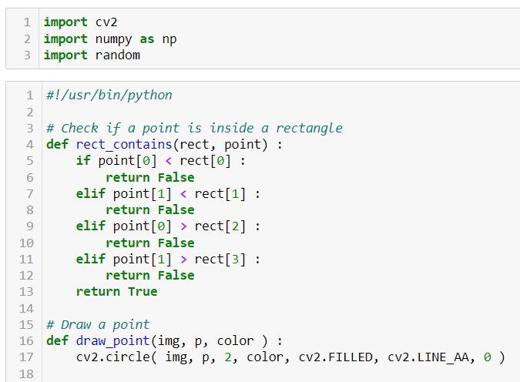

Slide 22
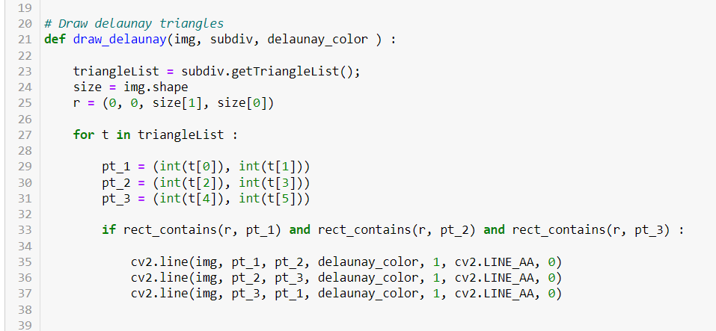

Slide 23
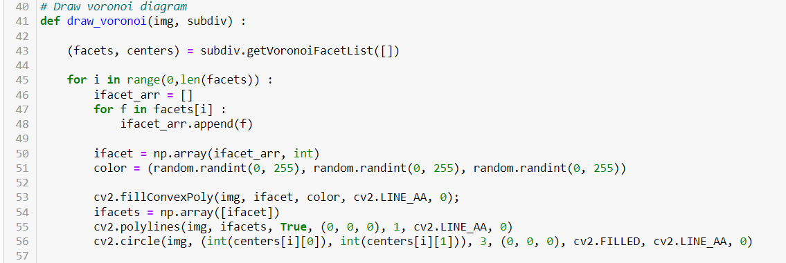

Slide 24
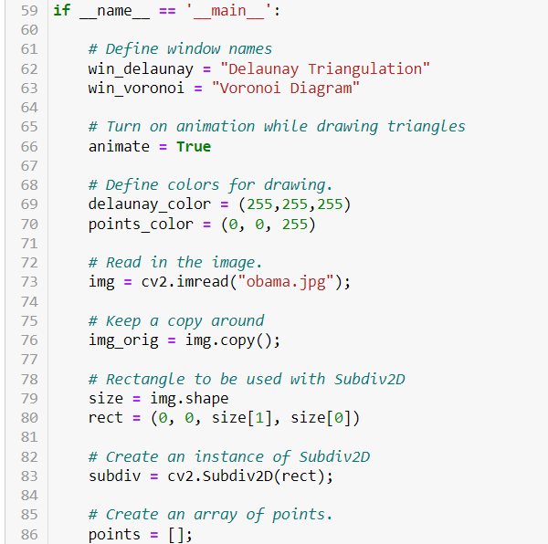

Slide 25
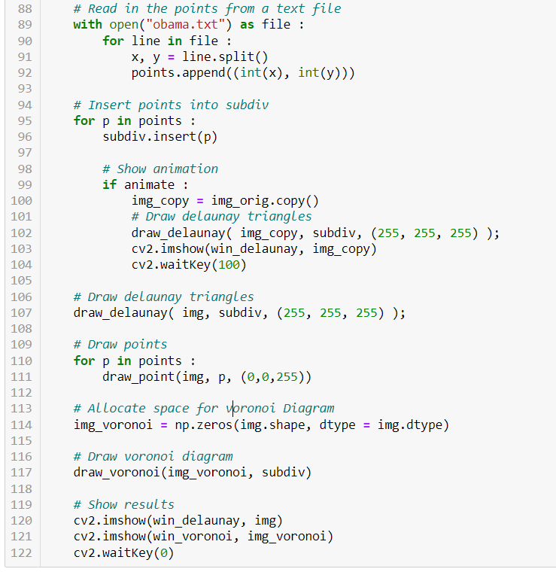

Slide 26
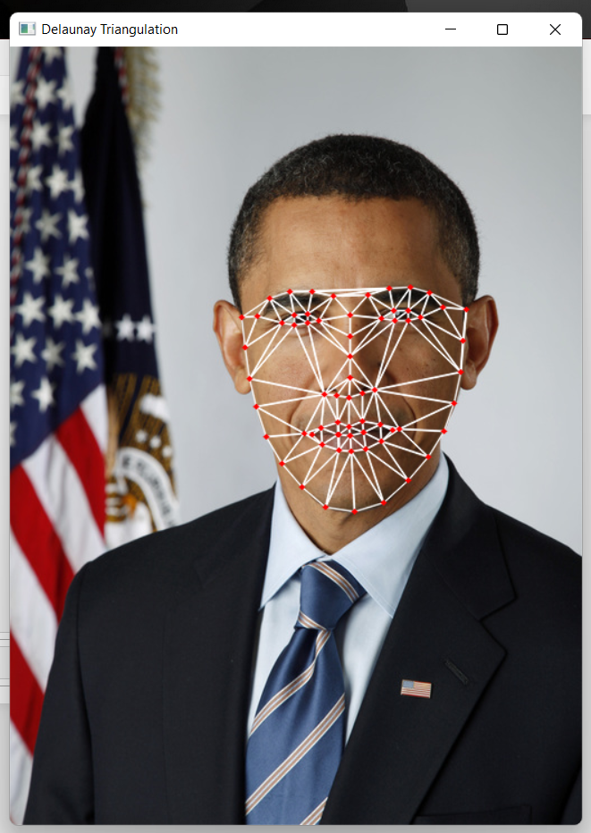
OUTPUT
Delaunay Triangulation

Slide 27
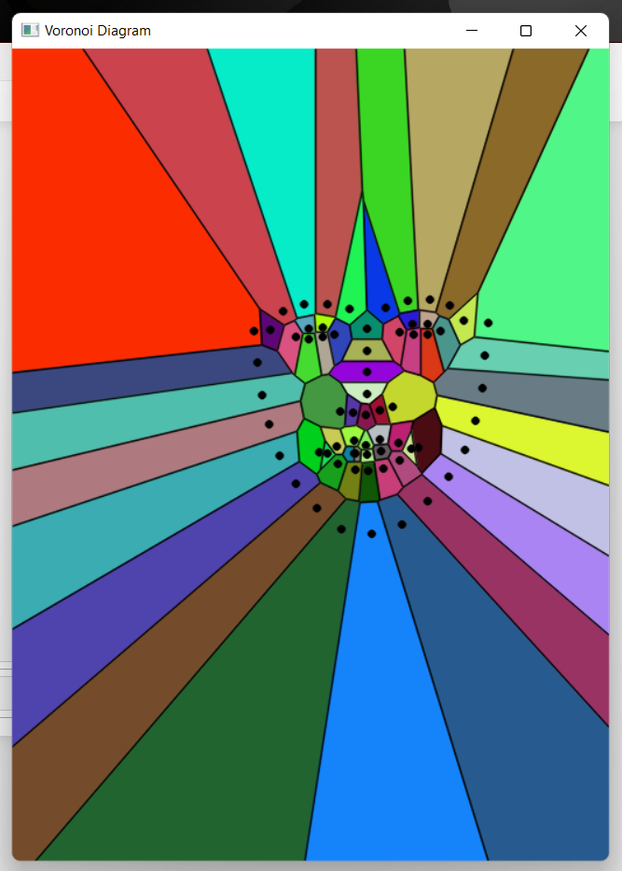
OUTPUT
Voronoi Diagram

Slide 28
Implementation of Convex Hull 3D based on Randomized Incremental Algorithm

Slide 29
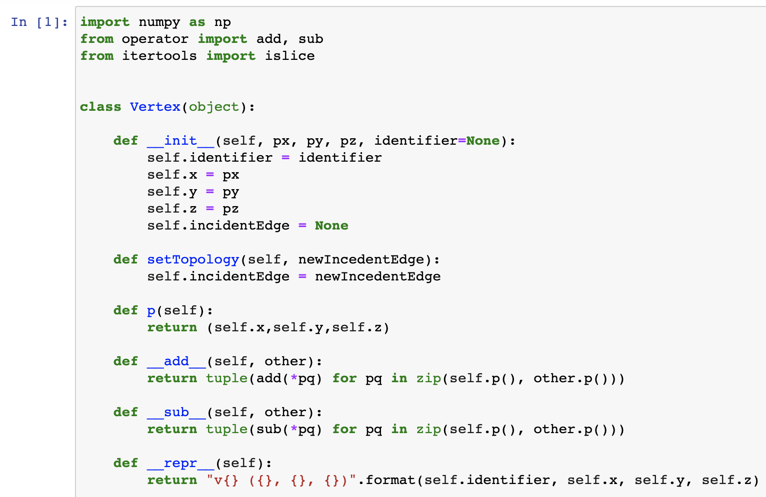

Slide 30
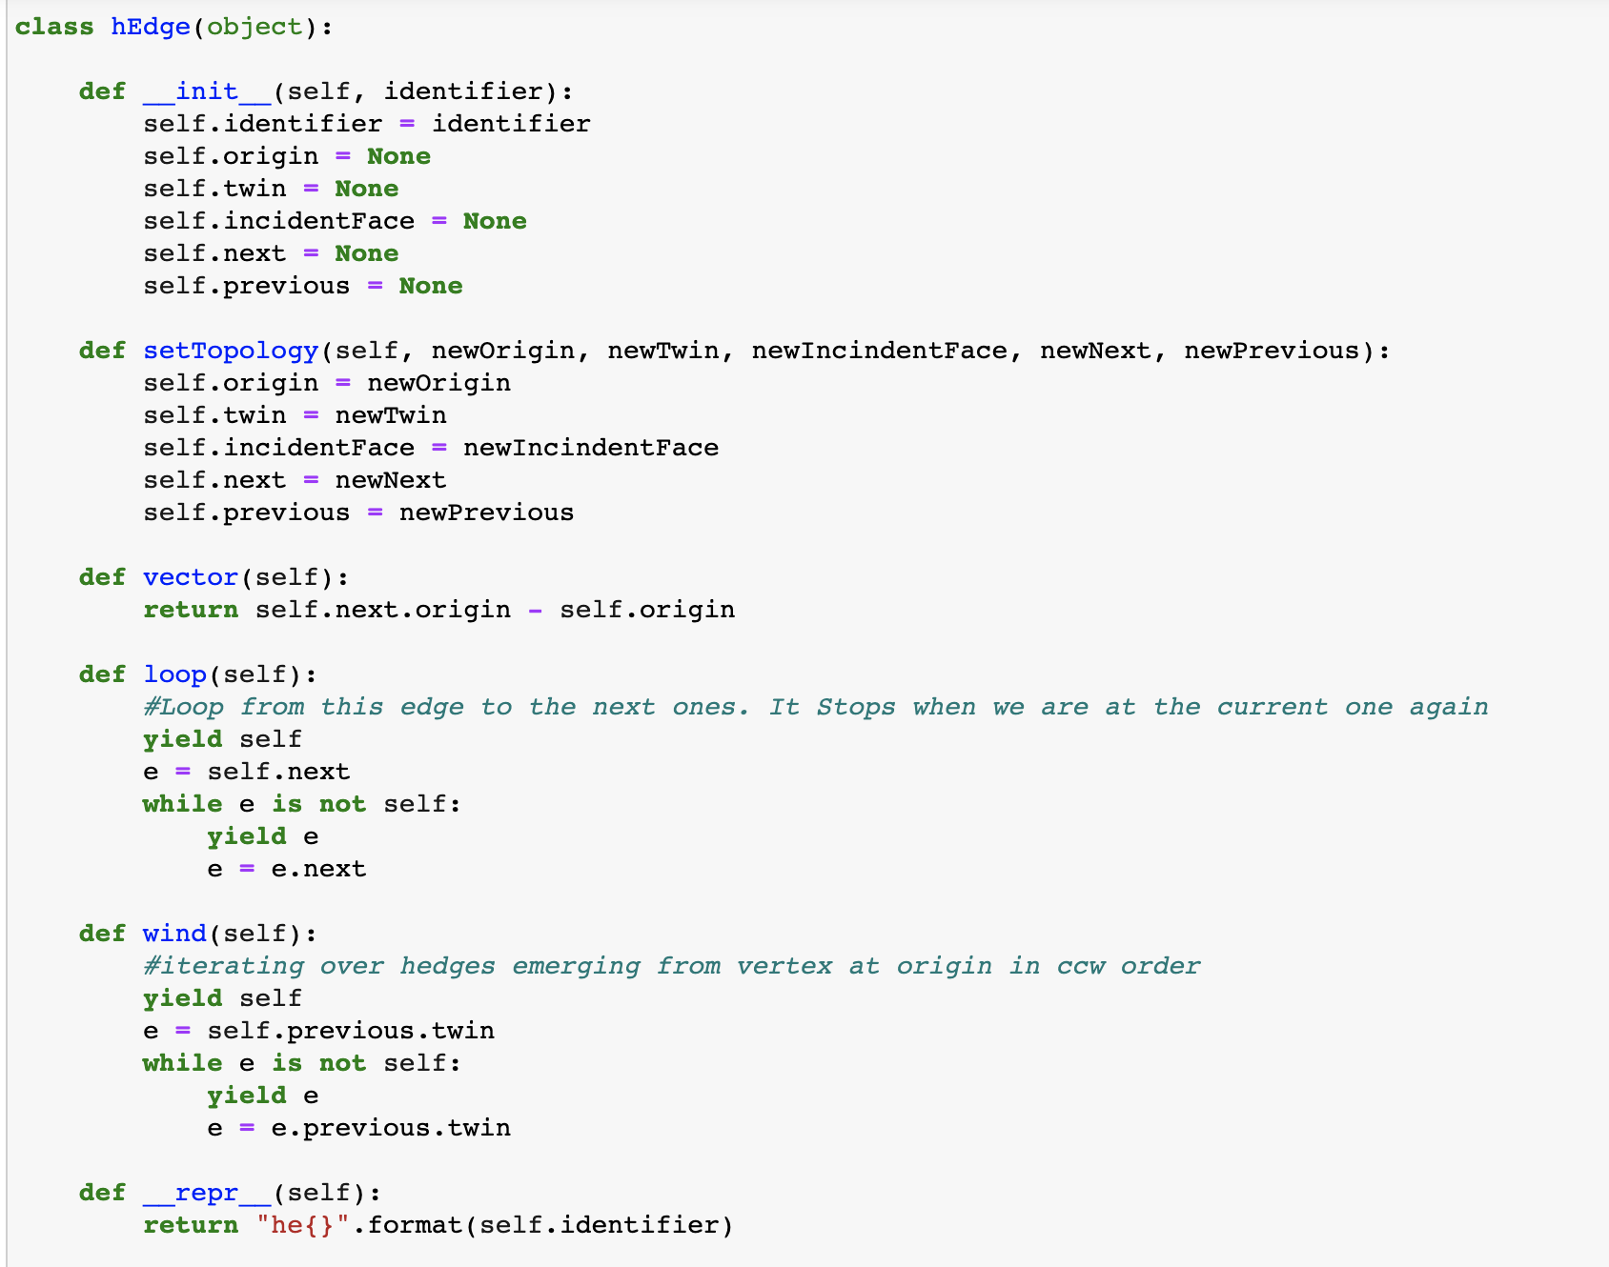

Slide 31
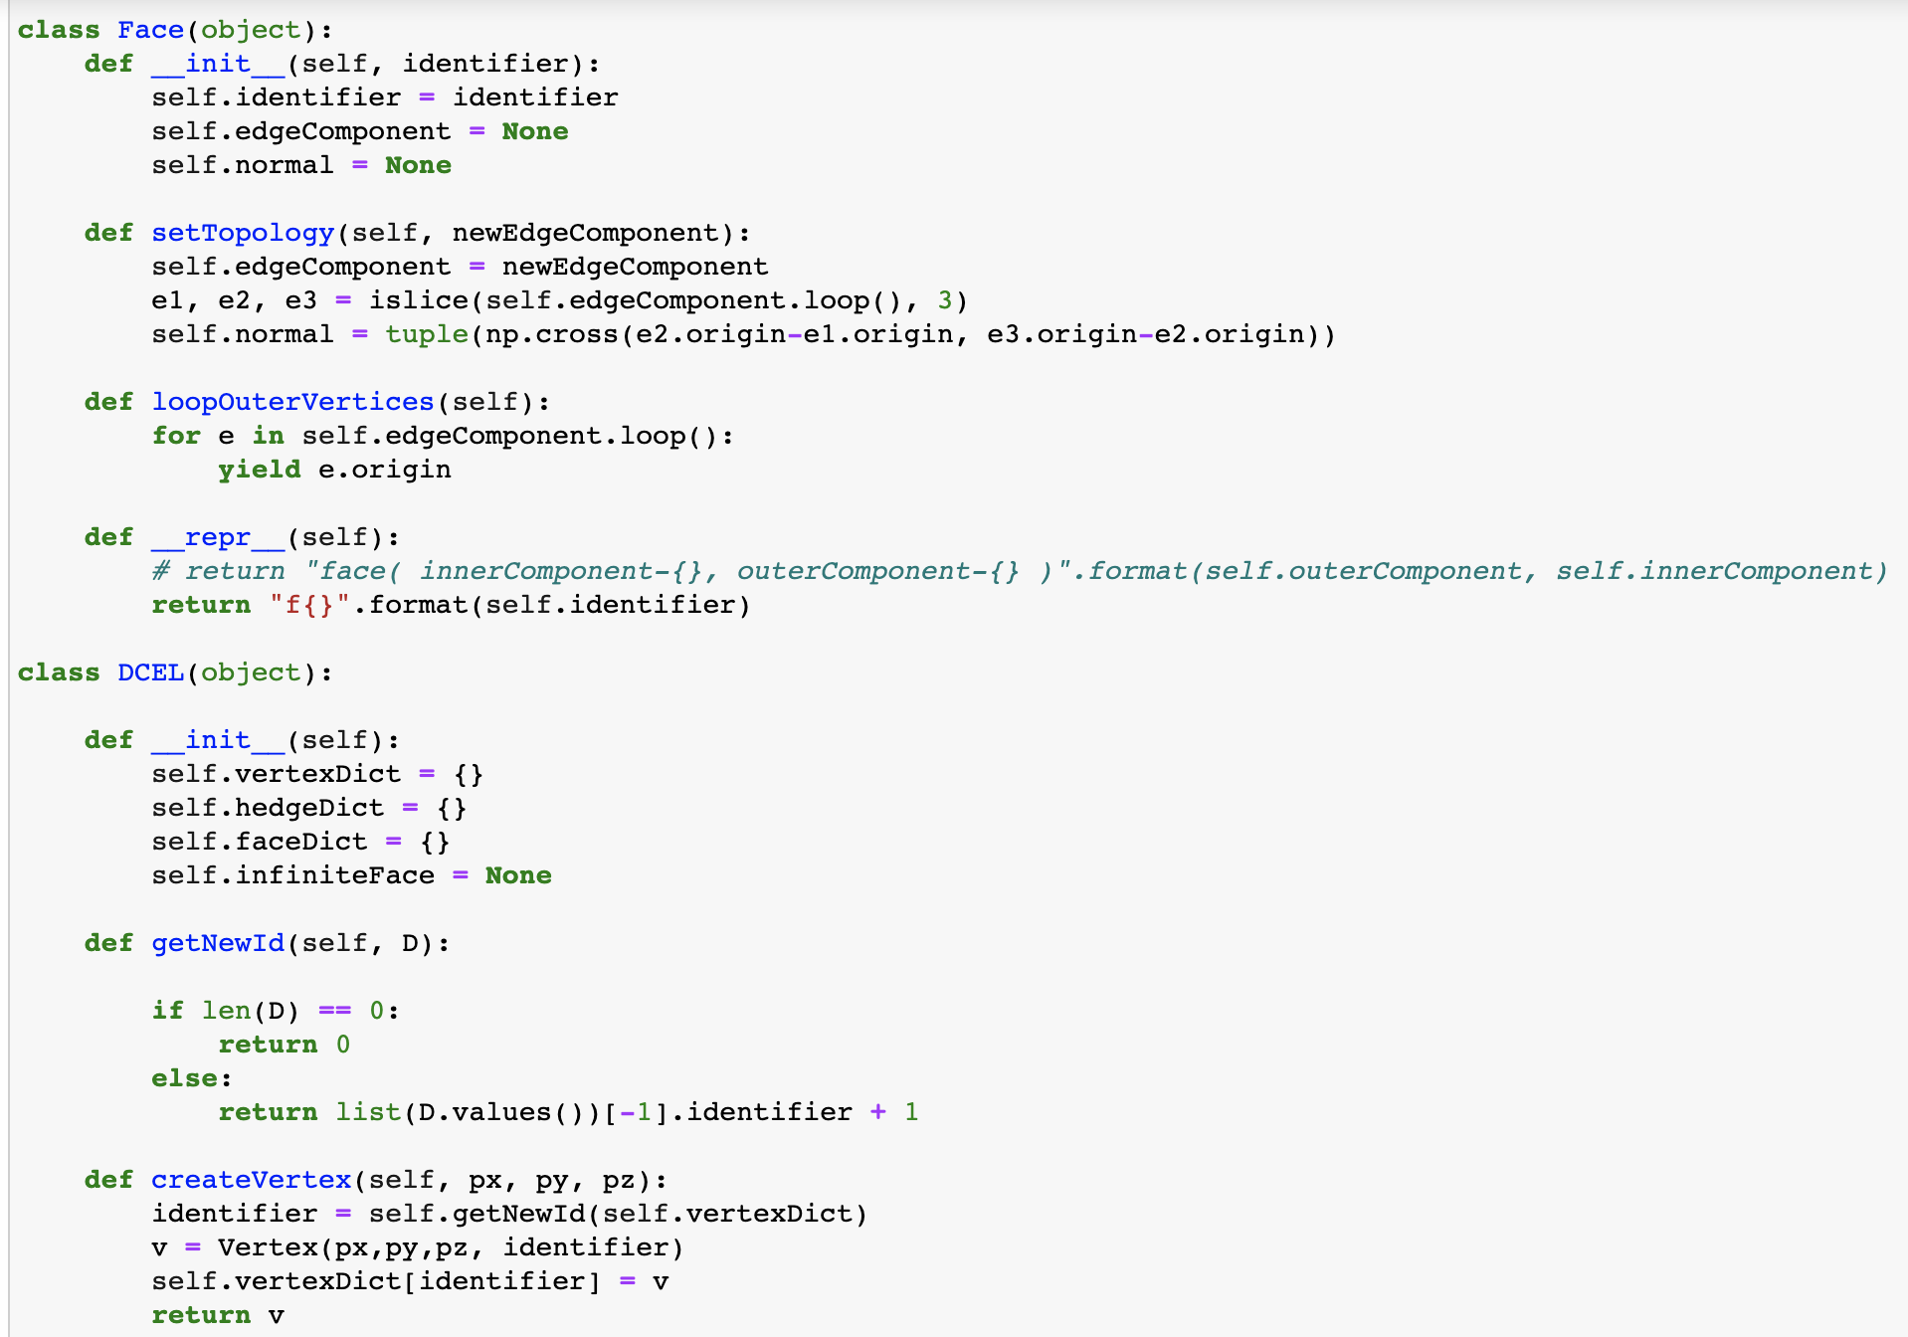

Slide 32
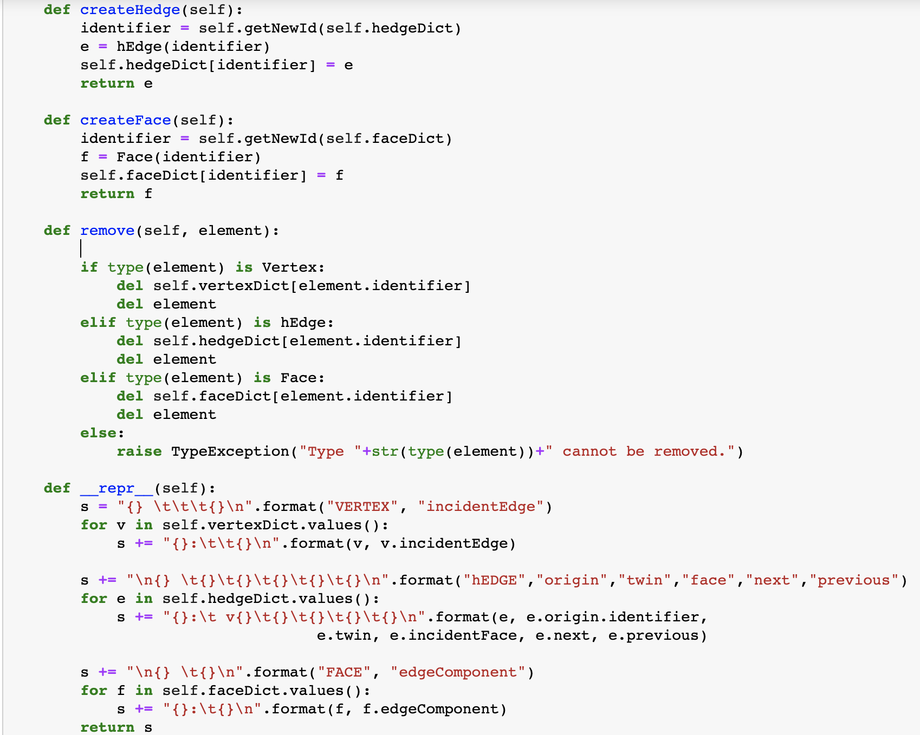
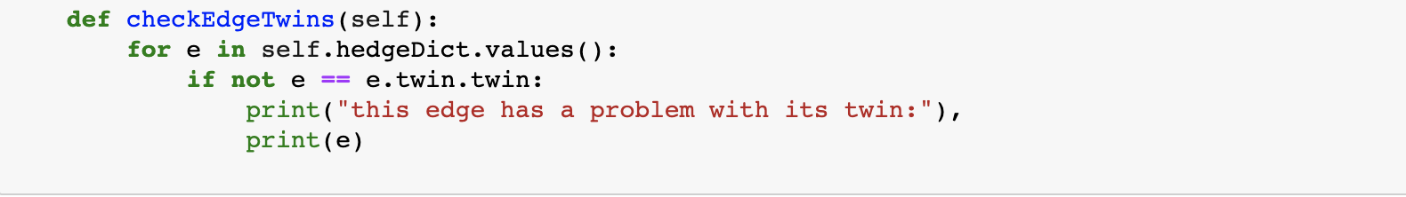

Slide 33
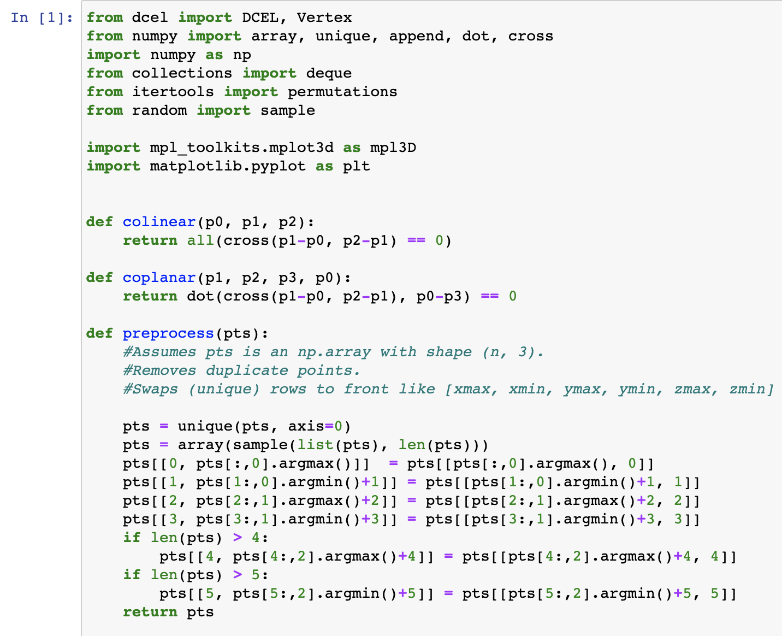

Slide 34
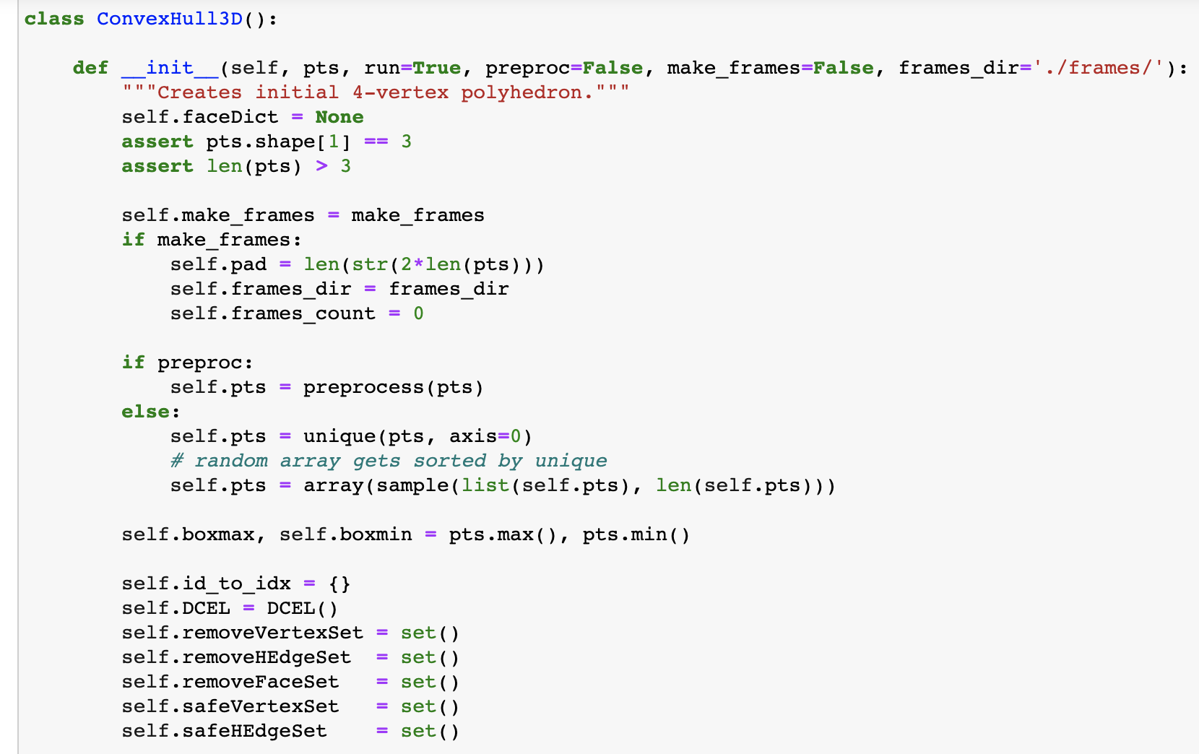

Slide 35
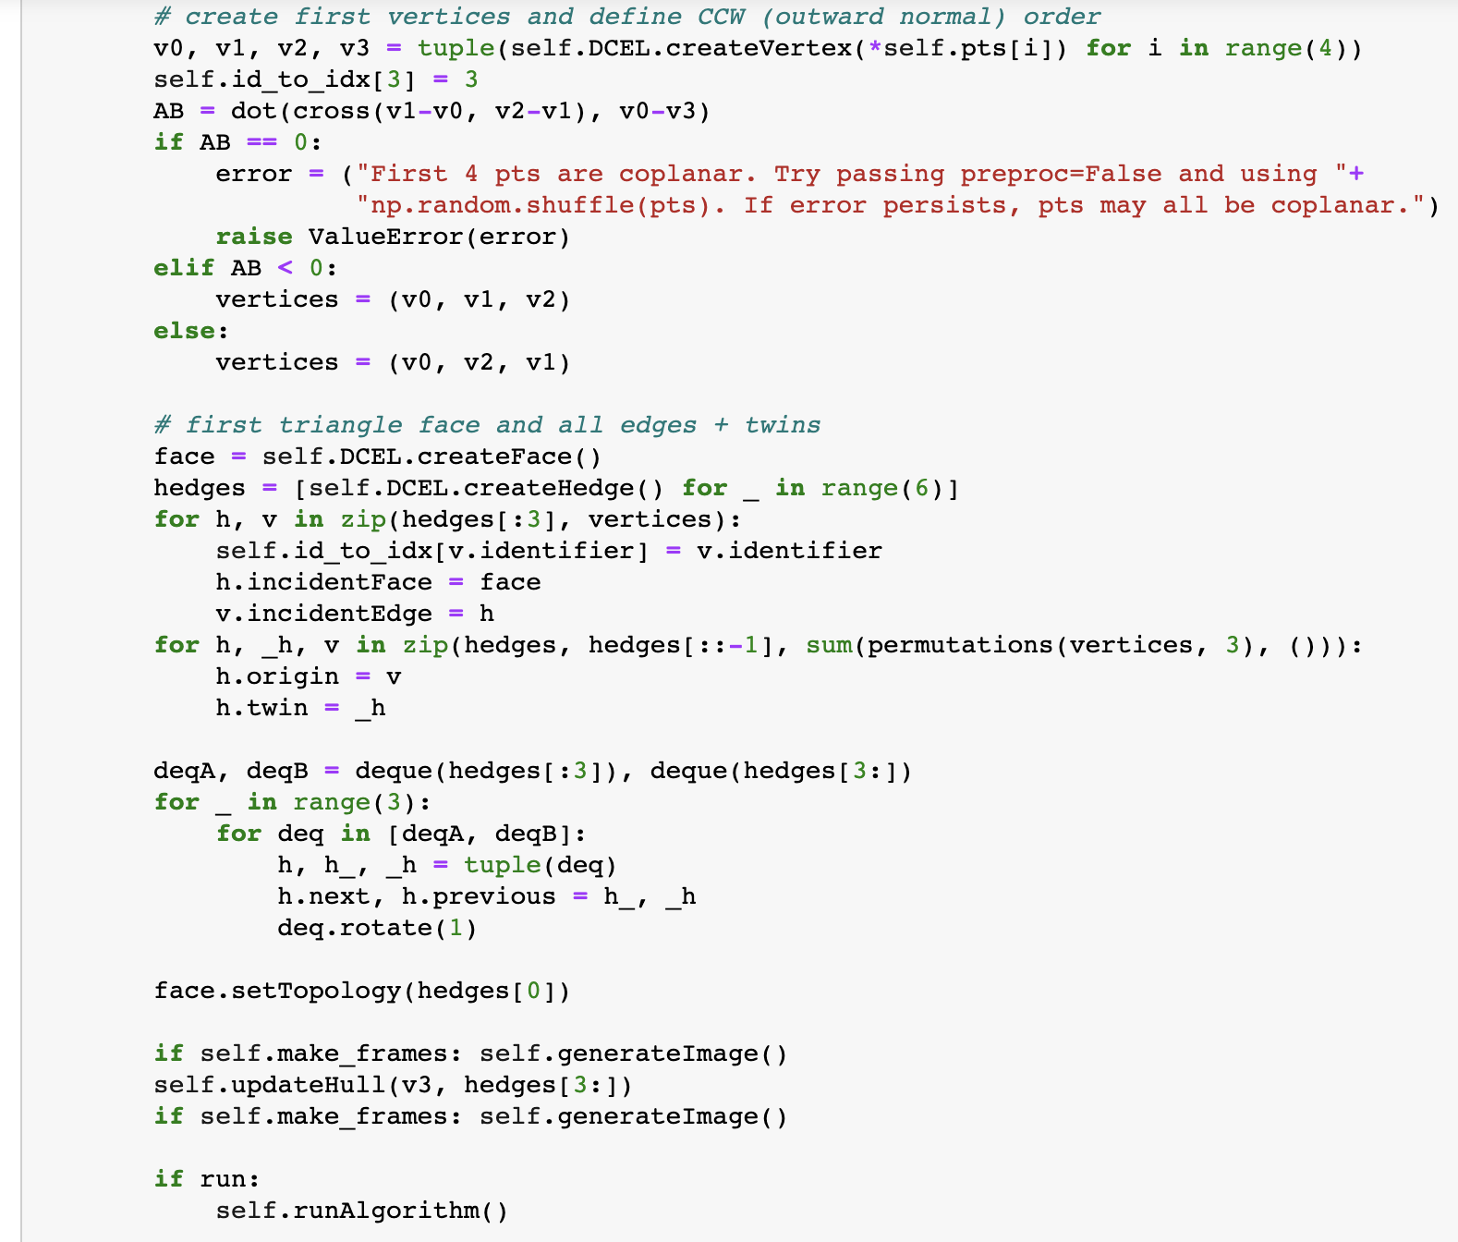

Slide 36
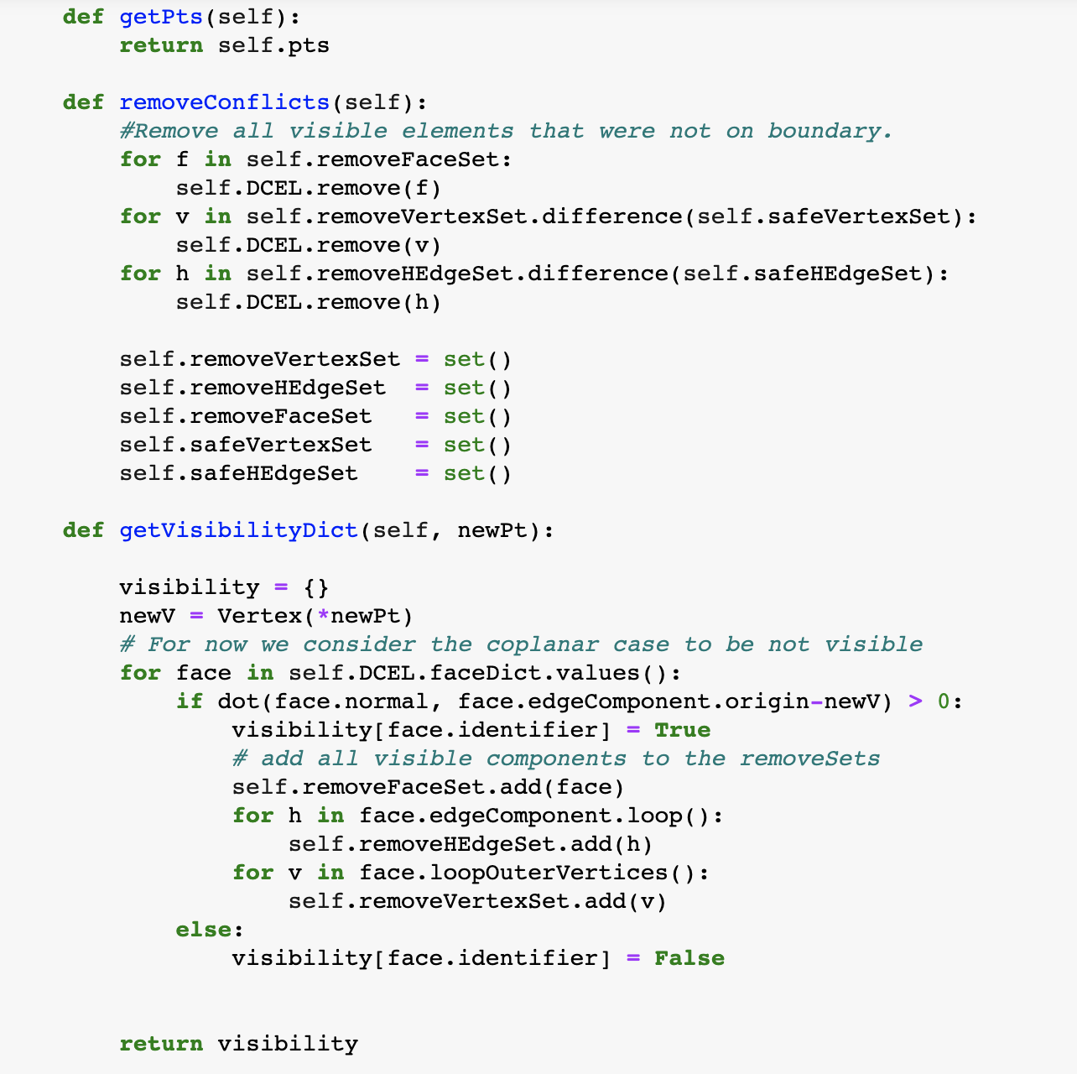

Slide 37
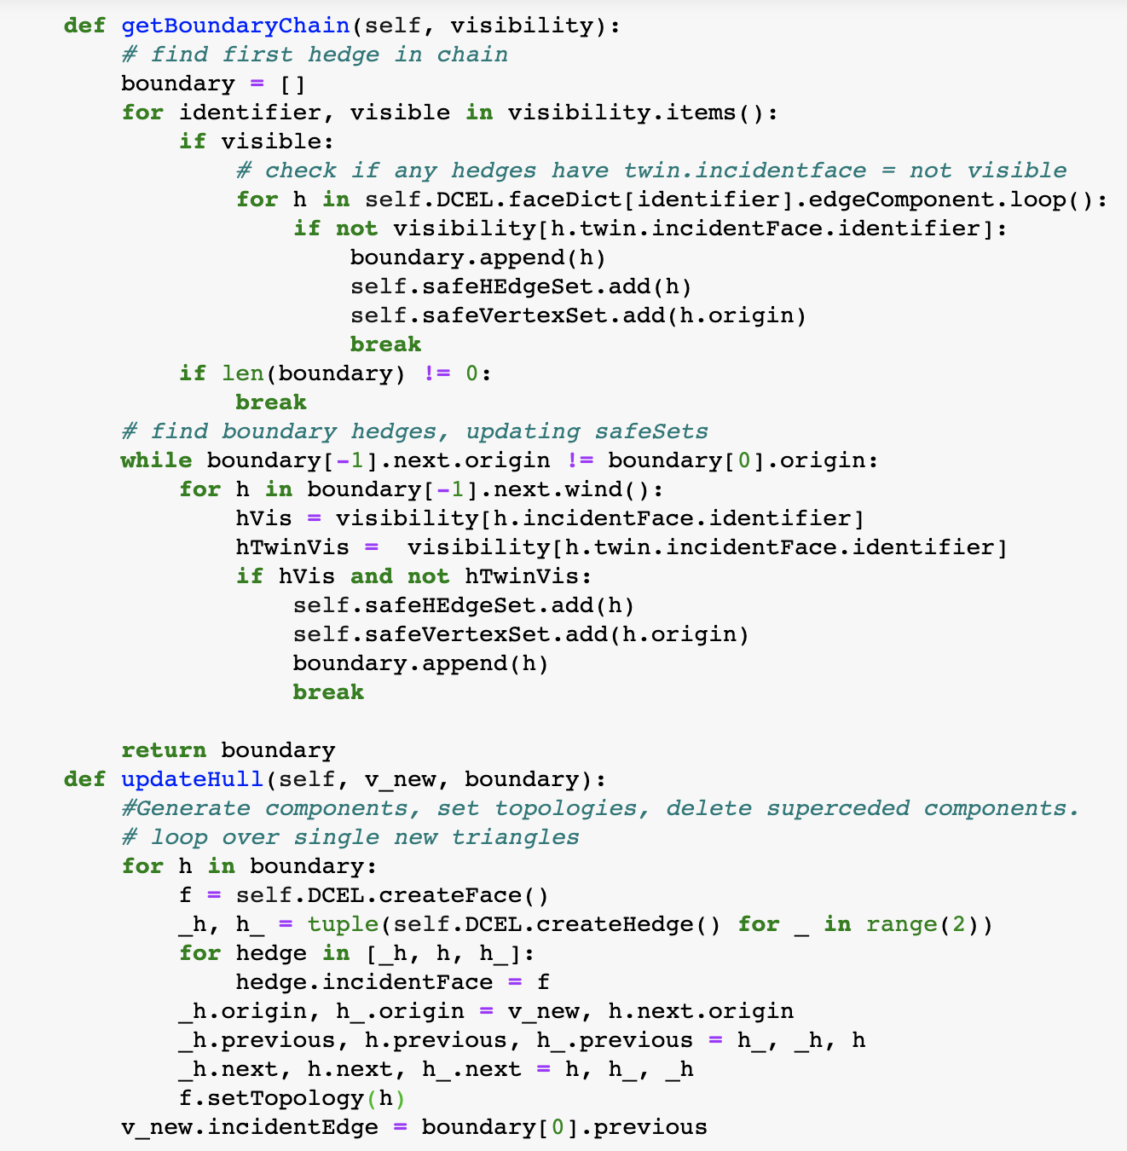

Slide 38
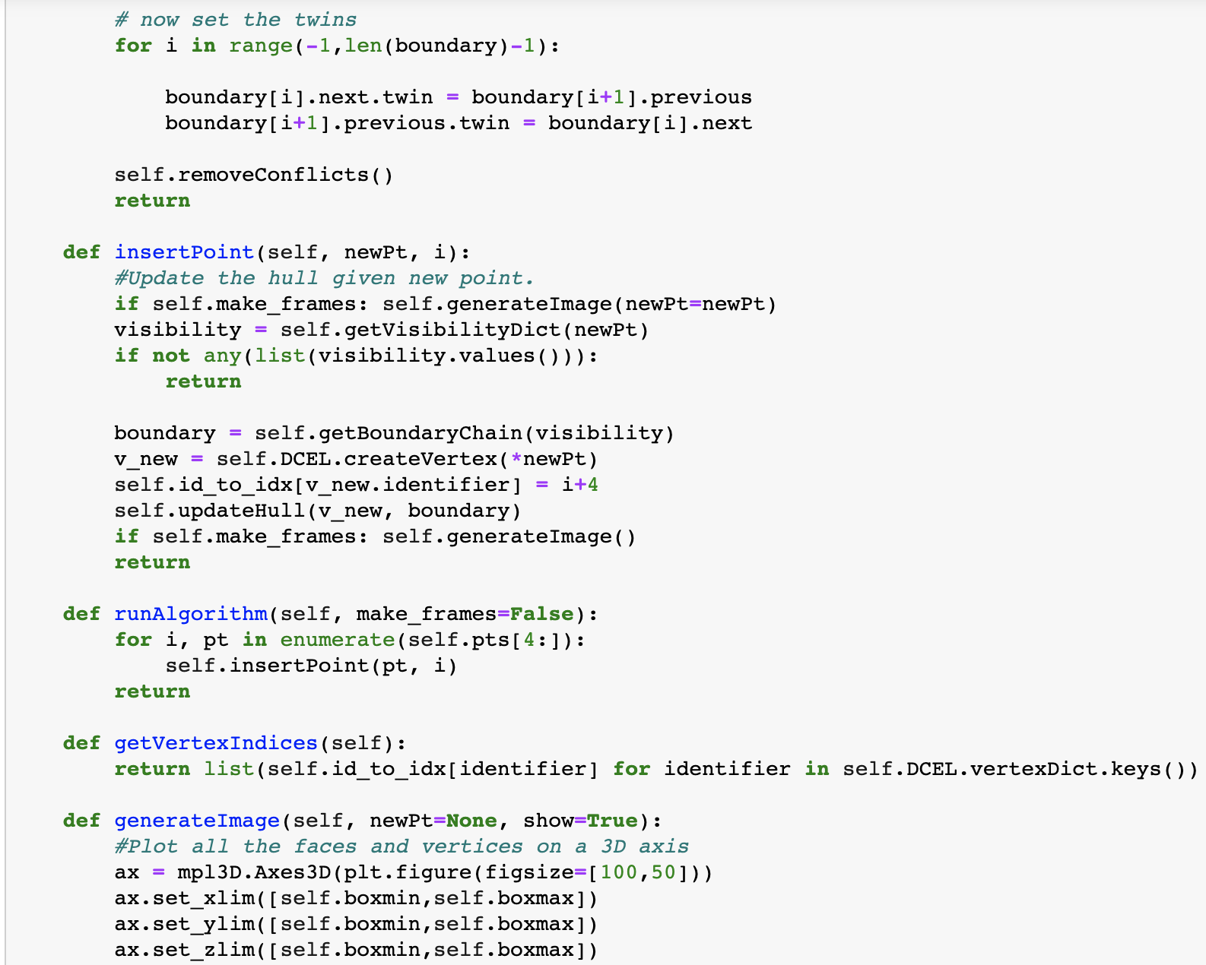

Slide 39
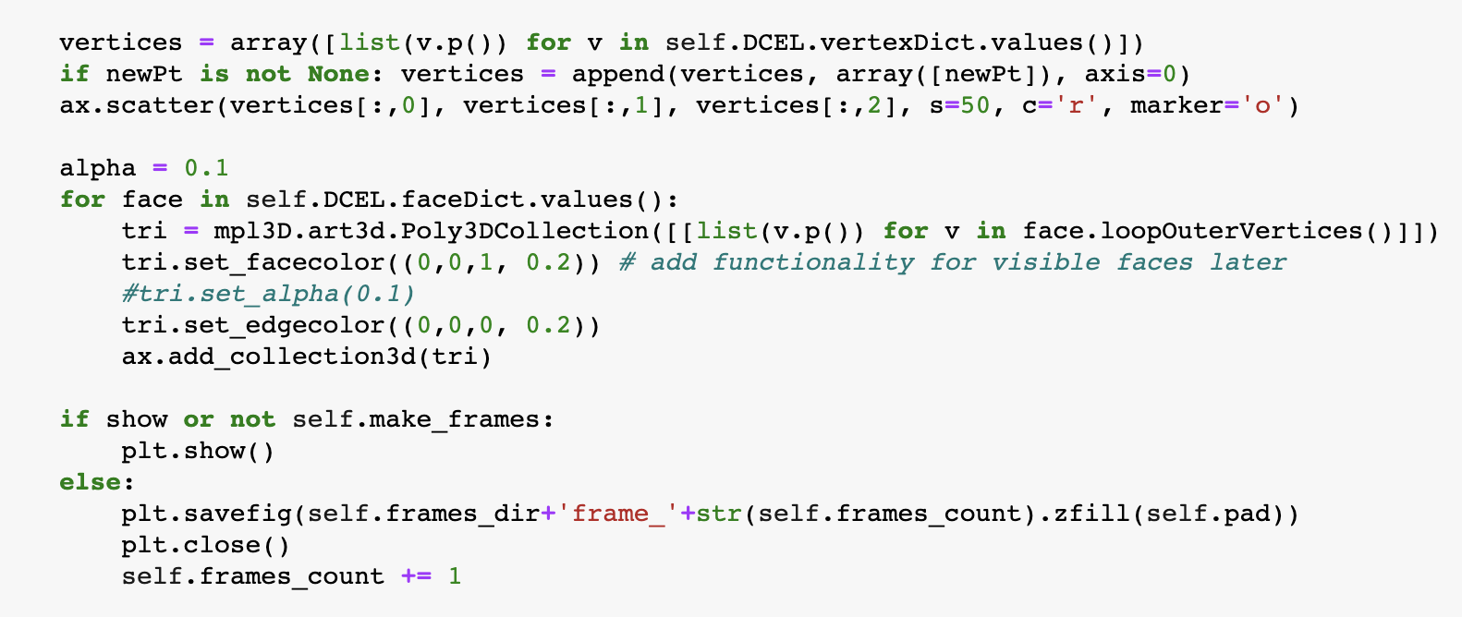

Slide 40
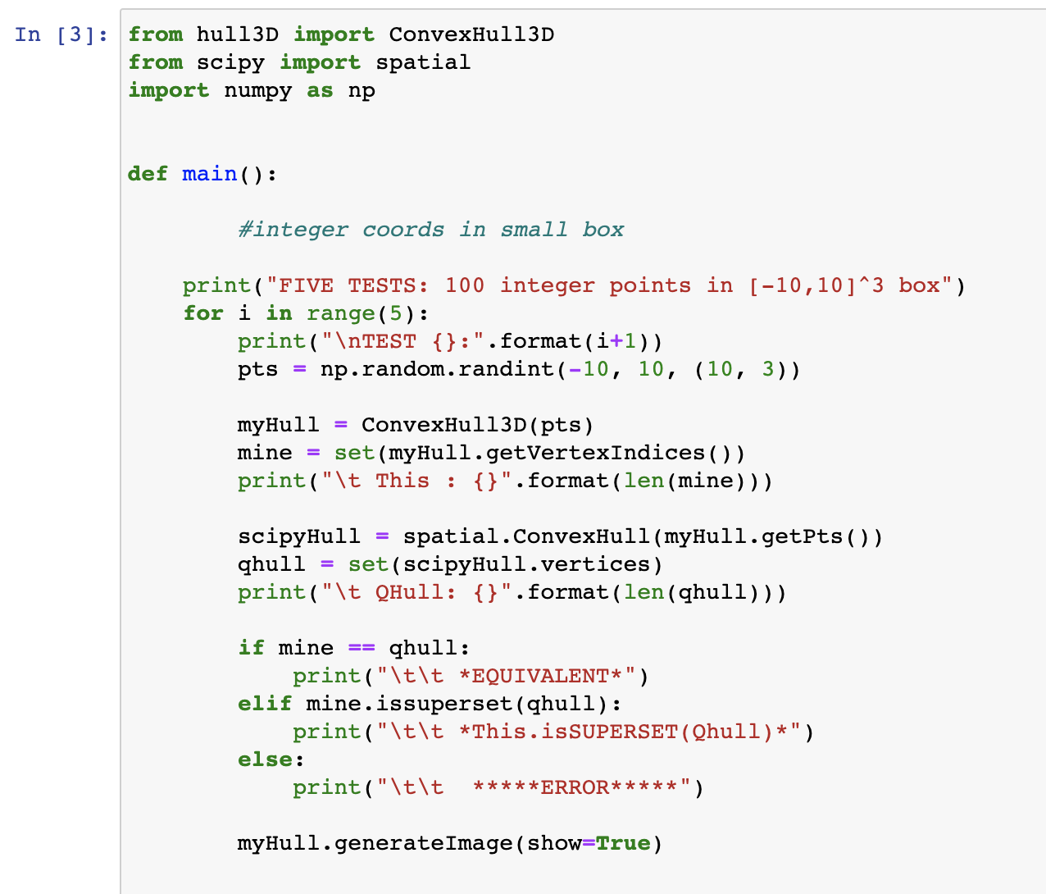
DRIVER CODE

Slide 41
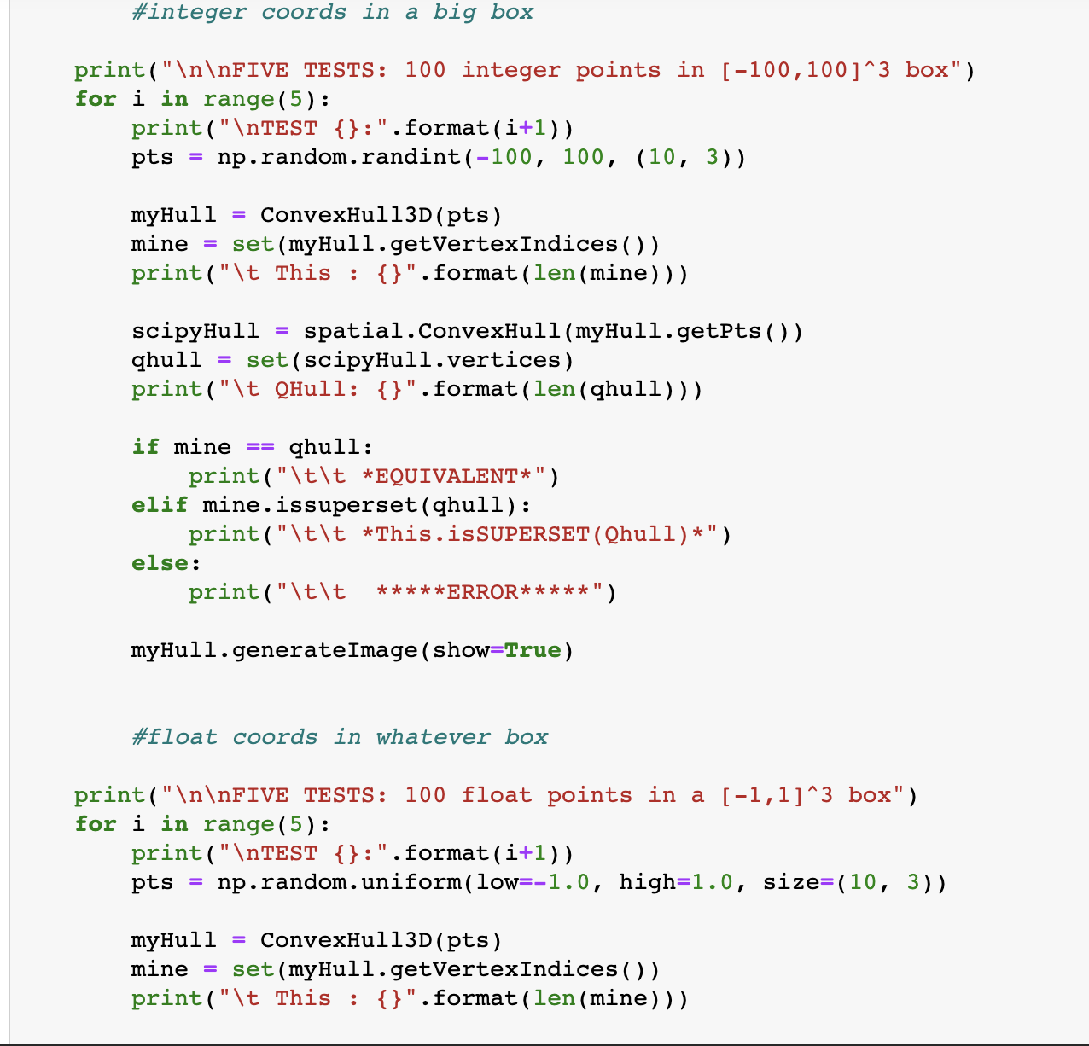

Slide 42
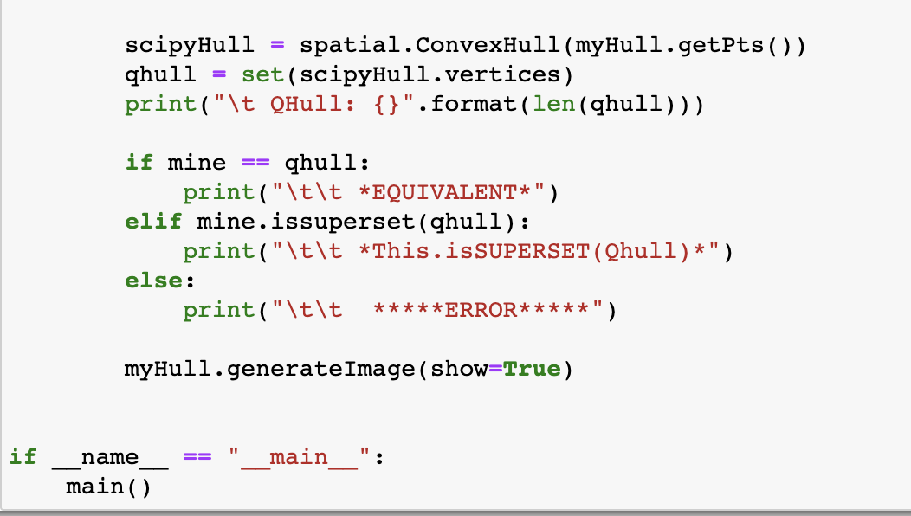

Slide 43
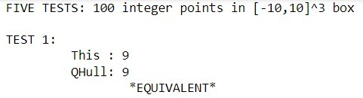
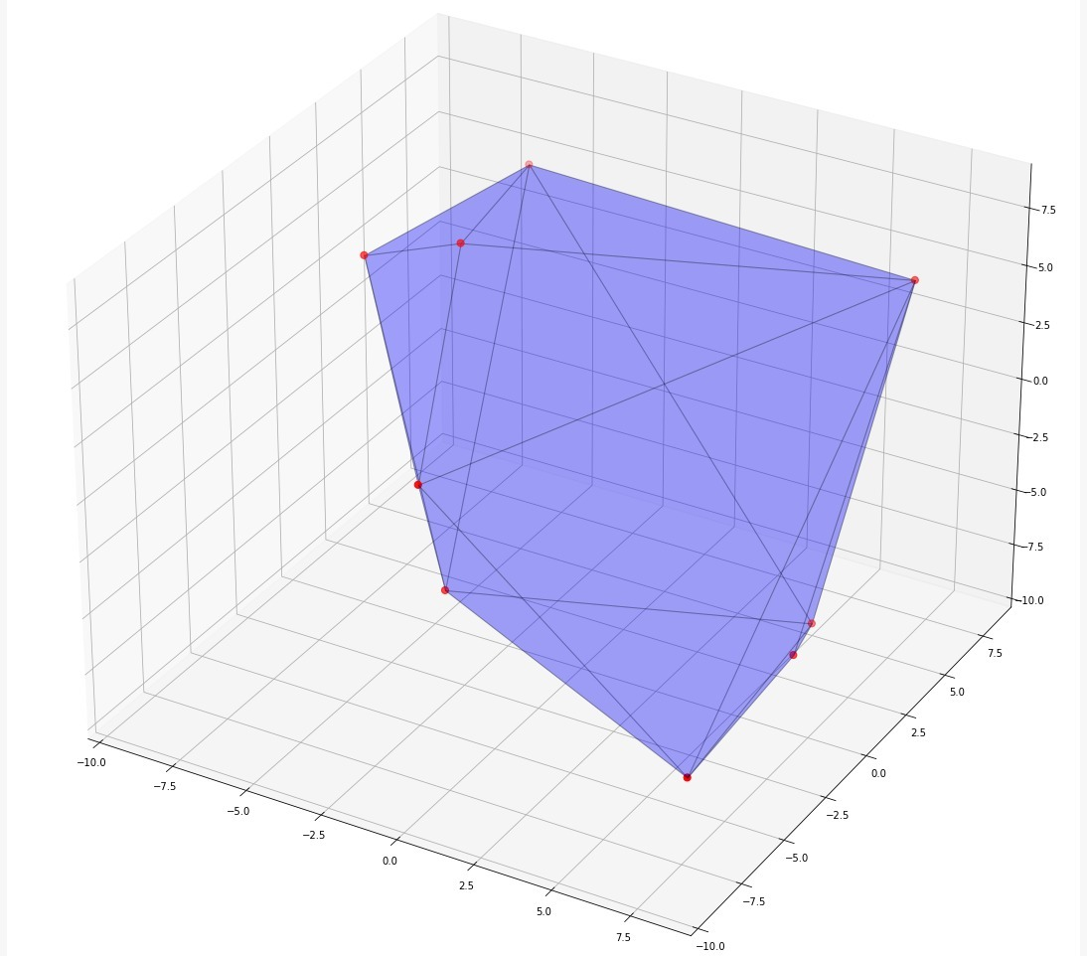
OUTPUTS
RANDOMLY
GENERATED CONVEX
HULL

Slide 44
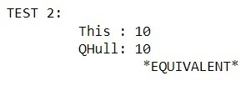
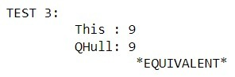
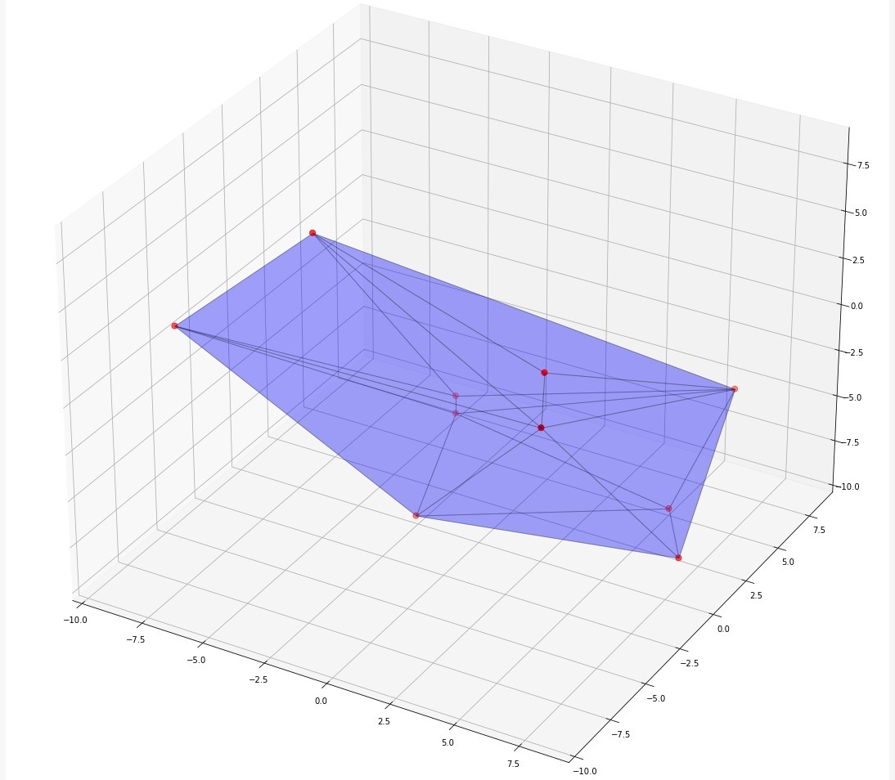
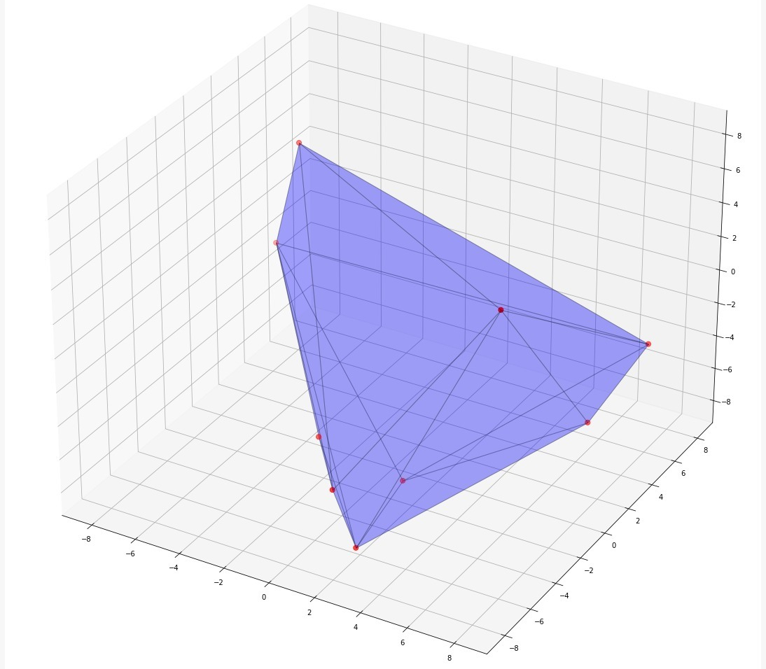

Slide 45
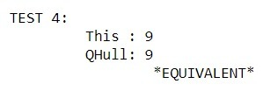
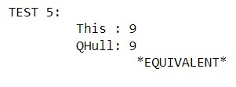
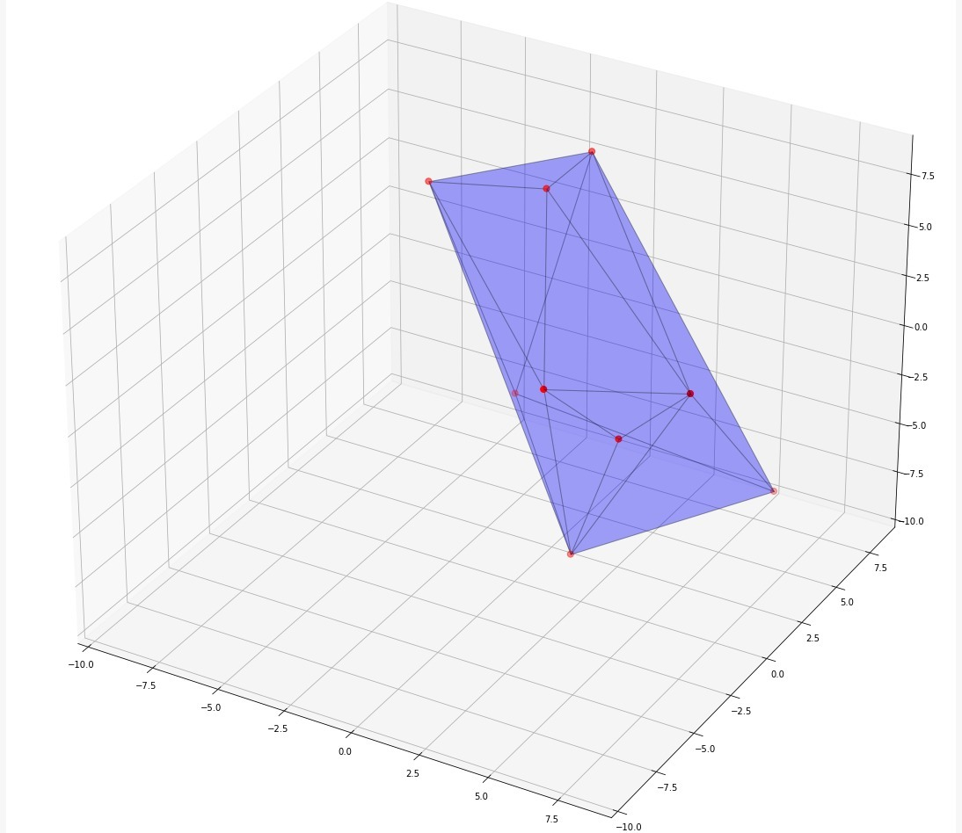
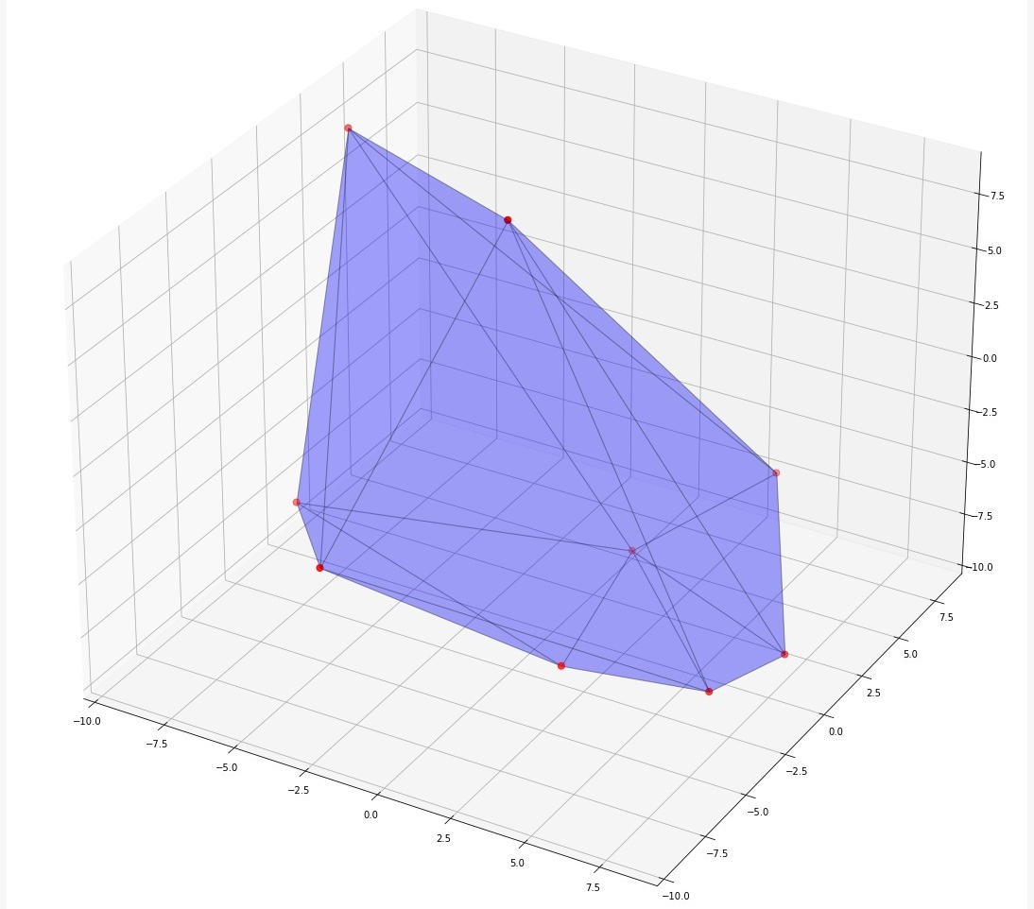

Slide 46
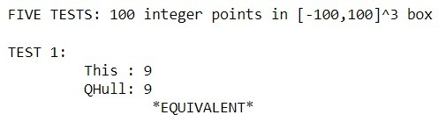
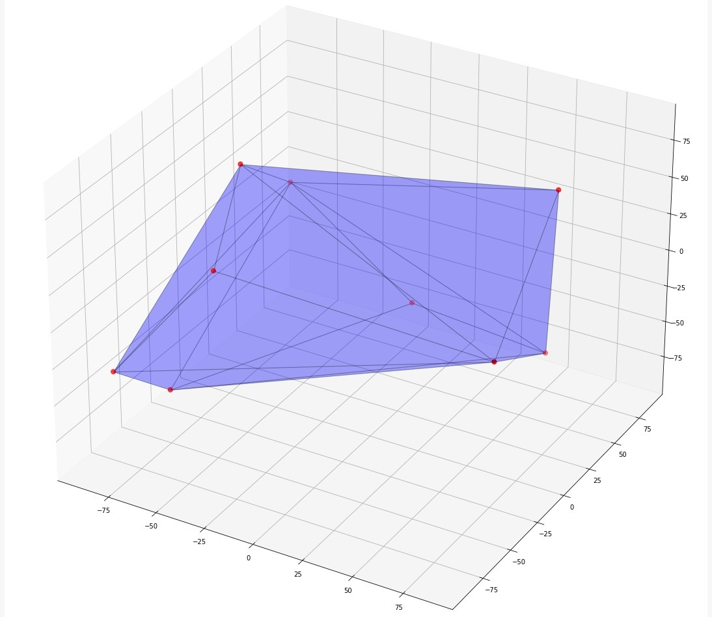
OUTPUTS
RANDOMLY
GENERATED CONVEX
HULL

Slide 47
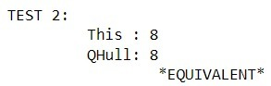




Slide 48





Slide 49


OUTPUTS
RANDOMLY
GENERATED CONVEX
HULL

Slide 50





Slide 51





Slide 52
Implementation of Convex Hull 3D based on Randomized Incremental Algorithm
Using OpenCV

Slide 53


Slide 54


Slide 55

OUTPUT

